Slide 1
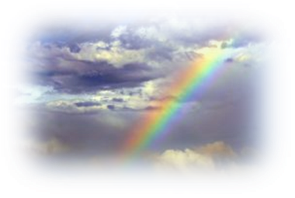
Rainbow Bridge
Author Unknown
This version is dedicated to all the pets, mine and yours, who have enriched our lives and made us better people.
© Stefanie Schwartz, 2011

Slide 2
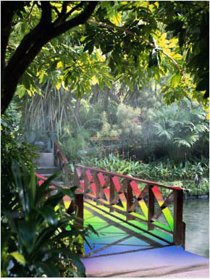
Just this side of heaven is a place called Rainbow Bridge.

Slide 3
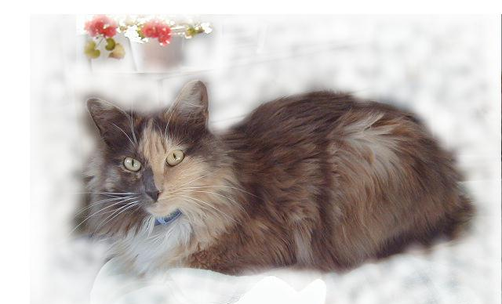
When an animal dies who has been especially close to someone here, he or she goes to Rainbow Bridge.

Slide 4
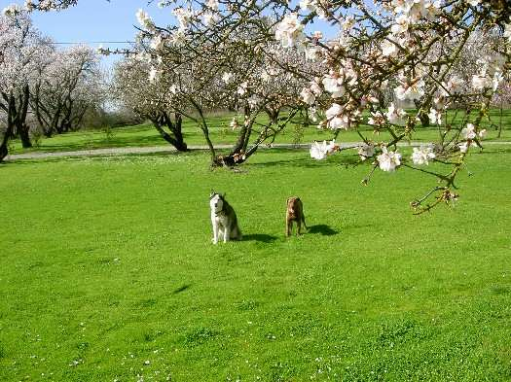
There are meadows and hills for all of our special friends so they can run and play together.

Slide 5
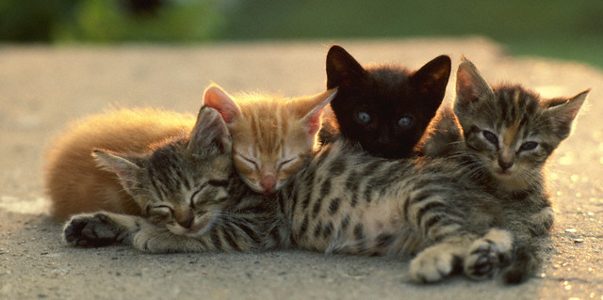
There is plenty of food, water, and sunshine, and our friends are warm and comfortable.

Slide 6
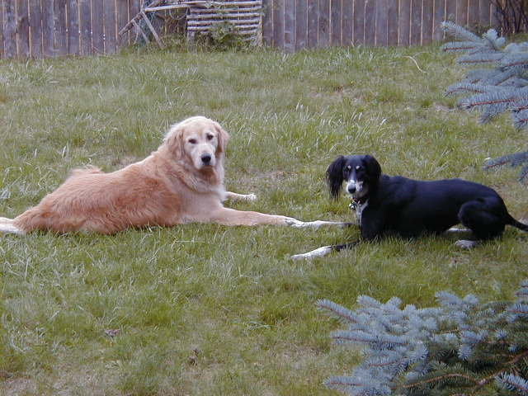
The animals who had been ill and old are restored to health and vigor.

Slide 7
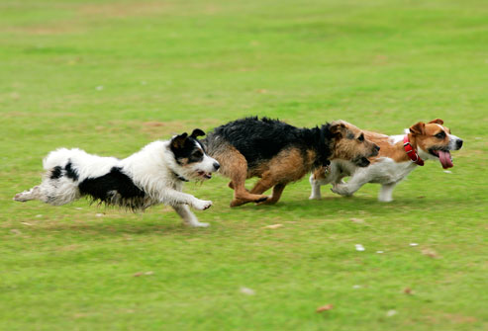
Those who were hurt or maimed are made whole and strong again, just as we remember them in our dreams of days and times gone by.

Slide 8
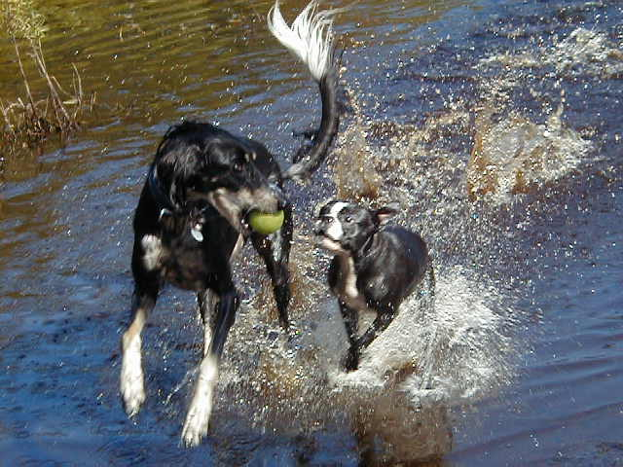
They all run and play together…

Slide 9
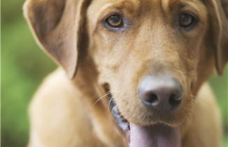
…but the day comes when one suddenly stops and looks into the distance. His bright eyes are intent. His eager body quivers.

Slide 10
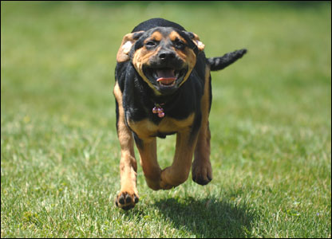
Suddenly he begins to run from the group, flying over the green grass, his legs carrying him faster and faster.

Slide 11
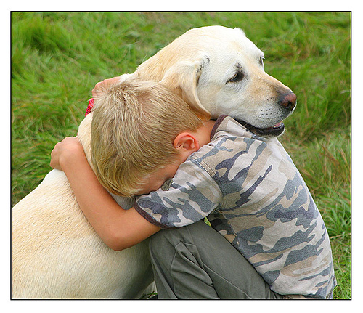
You have been spotted, and when you and your special friend finally meet, you cling together in joyous reunion, never to be parted again.

Slide 12
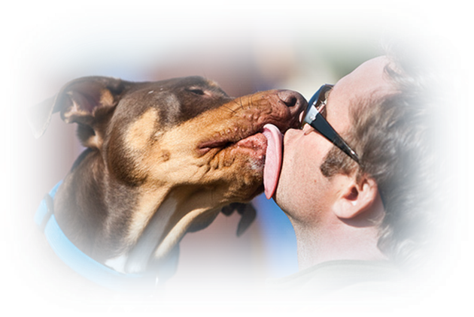
The happy kisses rain upon your face; your hands again caress the beloved head, and you look once more into the trusting eyes of your pet, so long gone from your life but never absent from your heart.

Slide 13
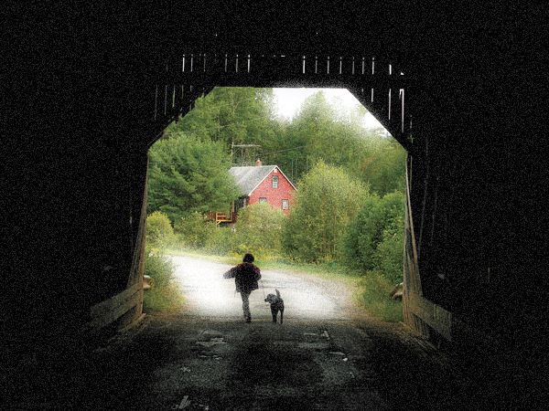
Then you cross Rainbow Bridge …together.

Slide 14
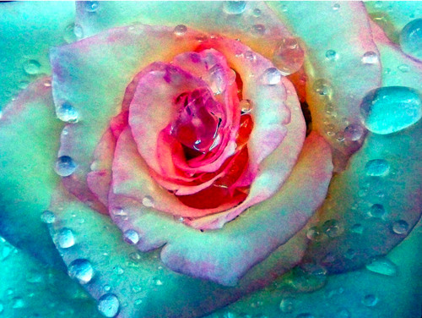
Walk on a rainbow trail;
walk on a trail of song, and
all about you will be beauty.
There is a way out of every dark mist, over a rainbow trail.
Navajo Song

Slide 15
Even in your darkest moments of despair, remember that a great soul does not fade after passing this life. Rather, it expands & lights up the darkness with memories of true love. Destiny will reunite you some day… in the blink of an eye.
Dr. Stefanie Schwartz
www.petbehavior.org

